Slide 1
Health Promotion Intervention.
Ethical Concerns for End-of-Life Care for the Uninsured Populations in the USA.

Slide 2
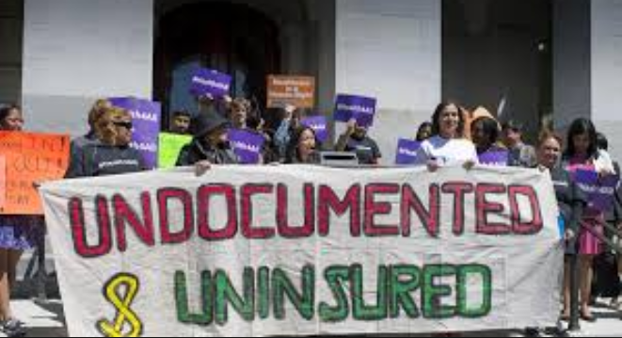
Introduction.
Health promotion facilitates peoples’ ability to increase their control over their health.
Health promotion goes beyond the patterns of individual behavior towards a wide range of social as well as environmental interventions.
There has been health imbalance amid different groups in the US.
Undocumented and uninsured populations need to be considered from an ethical point of view in health care (Fazel-Zarandi, Feinstein, & Kaplan, 2018).
Health promotion interventions are highly anticipated in the US.
Multiple programs may be oriented to the undocumented immigrants.

Slide 3
The Cohort Being Addressed.
Uninsured populations in the USA.
A group of people who have no health insurance.
America has a large number of undocumented and uninsured populations (Cervantes et al., 2017).
More than 11 million uninsured immigrants in the context of the United States.
Latino Americans are having the leading number of uninsured population.
Notes:
Uninsured population refers to a group of people who have no health insurance coverage. The number of undocumented and uninsured immigrants is growing in the context of the USA accounting to over 11 million uninsured immigrants in the US (Cervantes et al., 2017). Latino Americans are having the leading number of the uninsured population whose health status needs acute health promotion interventions.

Slide 4
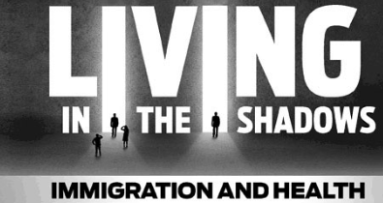
Need for health care providers’ intervention in caring for uninsured patients.
The undocumented Americans have been poorly represented and covered in the healthcare sector.
Undocumented Immigrants are not eligible for the Medicaid programs.
Undocumented immigrants are seen as underutilizing health care system (Fazel-Zarandi et al., 2018).
Increased underutilization of health care system subjects their health at risk.
Undocumented patients encounter hard times in dealing with end-of-life illnesses.
Notes:
According to health demographics, undocumented Americans have been poorly represented and covered in the healthcare sectors. As evidence, the US health care programs do not subsidize for health care costs for all undocumented patients, and this has facilitated underutilization of the health care system. Undocumented immigrants have often been challenged by the lack of balanced care services to address their end-of-life illnesses such as cancer among others (Fazel-Zarandi et al., 2018). In this setting, health care providers need to pull up their socks and defend for balanced healthcare.

Slide 5
Continuation of the need for health care providers’ intervention in caring for this group………..
Health care providers should advocate for universal coverage for both citizens and undocumented immigrants.
They should disseminate knowledge on end-of-life care for undocumented immigrants (Jaramillo & Hui, 2016).
Advocate for relaxation of Medicaid rules and regulations.
Advocate for undistinguishable care for undocumented patients.
Ensure increased access to health care services by immigrants.
Strategize for equality (Jaramillo & Hui, 2016).
Notes:
Also, health care providers should advocate for universal coverage for both citizens and undocumented immigrants to make undocumented patients eligible for health care services. Health care professionals should disseminate knowledge on end-of-life care for undocumented immigrants on the ethical benefits for balanced care. They should lobby for the government to relax health care rules and regulations to relieve the undocumented patient from fear of being segregated (Jaramillo & Hui, 2016). They should fight for the establishment of undistinguishable care for this cohort group. Moreover, they should strategize for health care equality as well as increased access to health care services by immigrants.

Slide 6
Importance of learning and addressing issues for the uninsured populations.
It will facilitate:
Understanding the experiences of undocumented patients.
Health promotion interventions from an evidence-based perspective.
Understanding of the common end-of-life issue with the population.
The need for ensuring ethically undistinguishable health care services.
Community understanding of the importance of widespread universal health care services.
Patient-centered care for undocumented patients (Jaramillo & Hui, 2016).
Proactive adherence to the undocumented patient’s concerns.
A basis for reinforcing ethics in the context of care.
Relieve for the undocumented immigrants from fear of deportation.
Notes:
Learning about issue attached to the undocumented popularizations will facilitate effective understanding of the experiences of undocumented patients such as underutilization of health care system, discrimination and lack of equality (Jaramillo & Hui, 2016). It will enhance health promotion interventions from an evidence-based perspective since it will facilitate increased research for better understanding. It will ensure effective adherence to the common end-of-life issues with the population.
Also, health care providers will be able to advocate for undistinguishable health care services to the undocumented patients. Community understanding of the importance of widespread universal health care services. It lays a foundation for patient-centered care for the undocumented patients. Proactive adherence to the undocumented patient’s concerns and this would probably facilitate improved care for uninsured populations in general. It will form a basis for reinforcing ethics in the context of care and hence relieve for the undocumented immigrants from fear of deportation.

Slide 7
Interventions being done by health care providers to address issues of concern for undocumented patients.
Advocacy for expansion of Medicaid program (Fox, 2017).
Documentation of the undocumented immigrants.
Active participation in health care policy meetings.
Advocacy for undistinguishable care.
Notes:
Health care providers have often shown concern to the issues of concern to the undocumented patient in multiple ways. They have persistently advocated for the expansion of Medicaid programs to make undocumented patients eligible for such health care services (Fox, 2017). They have strived or the documentation of the undocumented populations to ensure universal health coverage. Nurses have been determined to participate in health care policy meetings for acute representation of challenging issues in the provision of care for undocumented patients thus ensuring relaxation of rules and regulations.

Slide 8
Continuation of interventions being done by health care providers to address issues of concern for undocumented patients……….
Lobby for the government’s financial support (Warren, 2017).
Dissemination of public health education.
Research on core barriers for health care access amid the undocumented patients.
Improved attendance to cancer and other chronic disease screening services.
Notes:
Also, health care providers have been devoted in service provision as well as address issues of concern to the undocumented and uninsured population by lobbying the government for adequate financial support. Such a practice is believed to make it easy for availing health care facilities for undocumented patients and a chance for increasing their utilization of health care system (Warren, 2017). Health care professionals have often increased the dissemination of public health education through motivating immigrants to attend cancer and other chronic disease screening services for improved health. Ultimately, healthcare professionals have often carried out determined researched to examine barrier of healthcare access to the undocumented patients.

Slide 9

Why this topic is of interest.
Barriers to access to healthcare services.
Underutilization of health care systems (Fox, 2017).
Presence of ethically distinguishable care services.
Violation of the bioethical principle of justice (Jaramillo & Hui, 2016).
The topic paves the way for reflective of the Ethical Codes for Nursing.
Notes:
Ethical issues concerning the end-of-life care for the uninsured populations in the USA interests me in that it will help in understanding barriers of access to health care service amid the undocumented populations (Fox, 2017). It will give focus on the underutilization of health care service amid the group. It will form a basis for of ethically distinguishable care services to all patients regardless of color and origin (Jaramillo & Hui, 2016). More importantly, the topic interests me in that it paves the way for the application of ethical code for nursing.

Slide 10
Continuation of why this topic is of interest…..
It forms a basis for continuous quality improvement in the health care system.
It calls for collective responsibility to all health care stakeholders.
It lays a foundation for documentation of undocumented immigrants (Cervantes et al., 2017).
The facilitates recommendation for better Medicaid rules and regulations.
It facilitates an adequate understanding of the need for screening immigrants for chronic diseases.
It seeks to improve health for all undocumented immigrants.
Notes:
Moreover, the topic is worth this study in that it forms a basis for continuous quality improvement in the health care system. It calls for collective responsibility to all health care stakeholders such as health care professionals, the government and others. It lays a foundation for documentation of undocumented immigrants to make them illegible for medical care programs. It facilitates recommendation for better Medicaid rules and regulations. It shows the need for screening immigrants for chronic diseases and hence improving health for all undocumented immigrants (Cervantes et al, 2017).

Slide 11
Role of interested non-health care providers’/community members.
Interested non-health care providers should;
Advocate for expansion of Medicaid programs.
Lobby legislators for health care policy change (Fox, 2017).
Advocate for universal health coverage.
Educate undocumented immigrants on the need for screening for chronic illnesses.
Provide financial support to the health care facilities.
Notes:
Interested non-healthcare personnel should join hands with other stakeholders by advocating for the expansion of Medicaid programs to cover undocumented patients. They should lobby legislators for health care policy change in policy meetings. They should advocate for universal health coverage to enhance health care equality (Fox, 2017). They should educate undocumented immigrants on the need for screening for chronic illnesses. They should also provide financial support to health care facilities.

Slide 12
References.
Cervantes, L., Fischer, S., Berlinger, N., Zabalaga, M., Camacho, C., Linas, S., & Ortega, D. (2017). The illness experience of undocumented immigrants with end-stage renal disease. JAMA internal medicine, 177(4), 529-535.
Fazel-Zarandi, M. M., Feinstein, J. S., & Kaplan, E. H. (2018). The number of undocumented immigrants in the United States: Estimates based on demographic modeling with data from 1990 to 2016. PloS one, 13(9), e0201193.
Fox, R. C. (2017). Spare parts: Organ replacement in American society. Routledge.
Jaramillo, S., & Hui, D. (2016). End-of-life care for undocumented immigrants with advanced cancer: documenting the undocumented. Journal of pain and symptom management, 51(4), 784-788.
Warren, R. (2017). Zero undocumented population growth is here to stay and immigration reform would preserve and extend these gains. J. on Migration & Hum. Sec., 5, 491.

